Slide 1
Chiron Group SE:
Challenge: Feed rate dips resulted in defective parts due to the technology used. In addition, sharp jumps in speed led to contour violations.
Solution Analyze MyWorkpiece /Toolpath
Identify defects on the workpiece – from design and programming down to processing on the machine.
"By using Analyze MyWorkpiece /Toolpath, we were able to significantly improve cycle time and, above all, process reliability.
Thanks to the in-depth analysis capabilities, no plant resources are wasted. The interaction with the digital twin of our AMCube quickly led to approaches so that our code generation could be optimized for the machine."
Error-parts on the actual machine were reduced by
up to 99%

Slide 2
Analyze MyWorkpiece /Toolpath, Chiron Group SE – Process optimization through part program analysis and the digital twin
Digital Industries

Slide 3
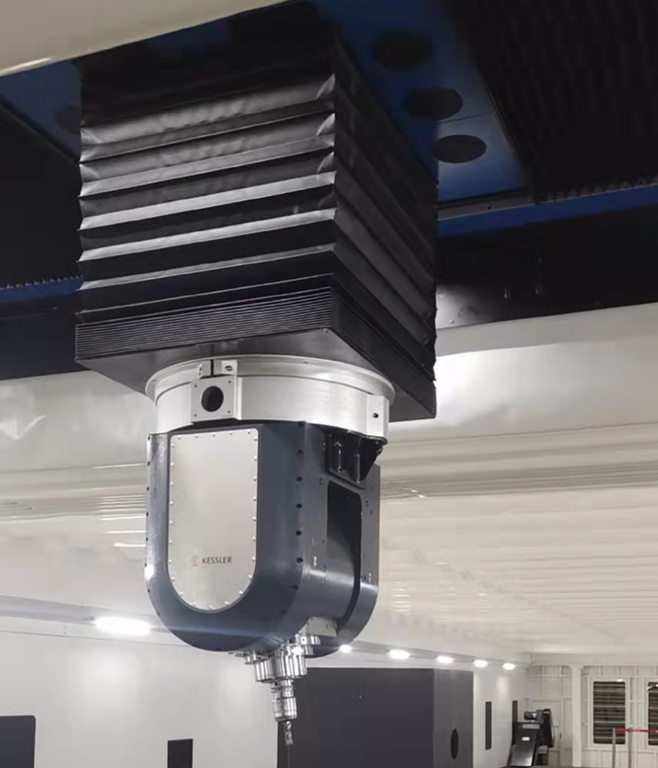
Analyze MyWorkpiece /Toolpath, Chiron Group SE - Improve process stability and reduce cycle times
Customer profile | Chiron Group SE is a specialist for vertical milling and mill-turning machining centers as well as for turnkey and automation competence.
Customer objectives | Early detection of problematic areas in the parts program. Optimization of the web feed rate when machining a freeform via CNC robot in additive manufacturing
Siemens Solution | By using Analyze MyWorkpiece /Toolpath together with Create MyVirtual Machine, the G-code from the CAD-CAM environment (NX) can be analyzed for incorrect contour curvature that interfered with the compressors. This enabled both increasing and smoothing the feed rate.
Customer value | Accelerated identification of causes for quality problems in workpieces Increased workpiece quality Better control of process quality and stability Optimization of the CAD-CAM chain with regard to the best possible G-code output
Why Siemens? | With Analyze MyWorkpiece/Toolpath, Siemens has a product that is deeply integrated into the overall system and provides optimal access to SINUMERIK data. In interaction with Create MyVirtual Machine, the digital twin of Sinumerik, optimization/diagnosis can be carried out completely at the desk.
"Deep analysis capabilities of the part program as well as the NC output allowed us to target problem areas in the part program generation. This helped us optimize our CAM setup."

Slide 4
Analyze MyWorkpiece /Toolpath, Chiron Group SE - Improve process stability and reduce cycle times
Customer profile
The Chiron Group SE is specialist for vertical milling and mill-turning machining centers as well as for turnkey and automation competence. They offer comprehensive services, digital solutions and products for additive manufacturing.

Slide 5
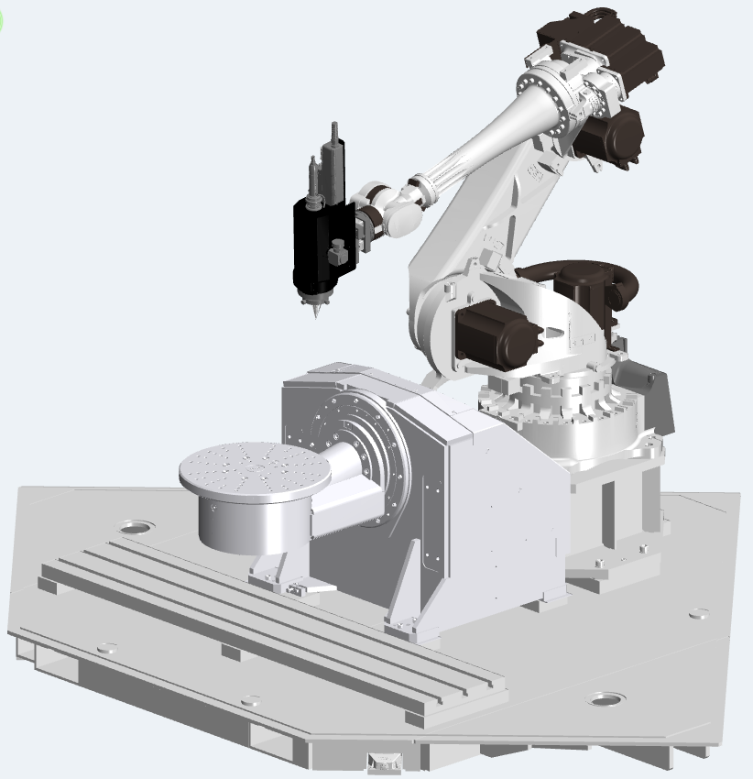
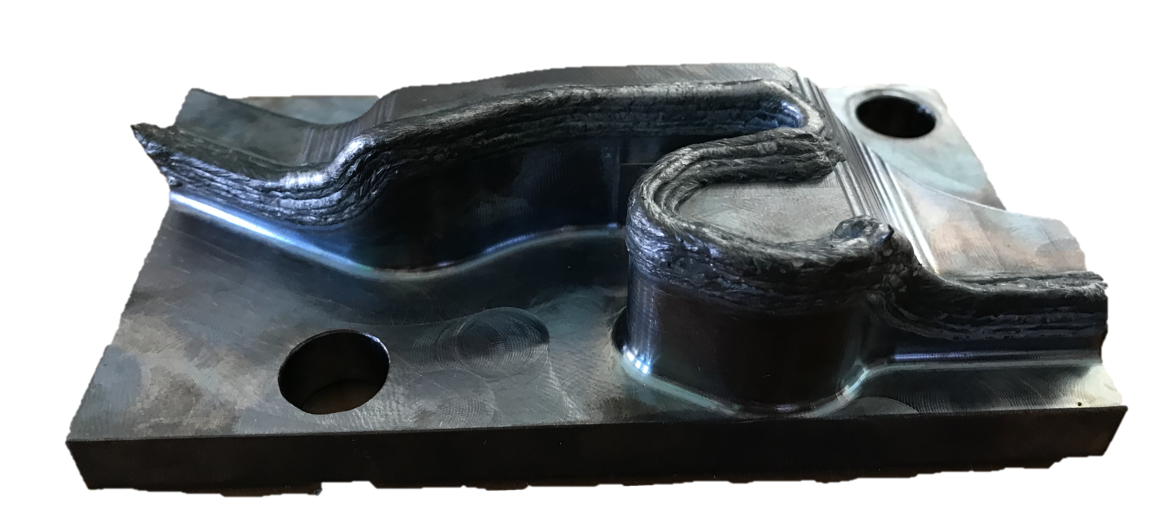
Analyze MyWorkpiece /Toolpath, Chiron Group SE - Improve process stability and reduce cycle times
Customer objectives
Due to constant material output, the thickness of the coating increased when the speed was reduced.
With Analyze MyWorkpiece/Toolpath it should be analyzed whether the speed dips are caused by the part model, the program, the machine parameter settings, or the machine mechanics.
Notes:
The machine in question is a 6-Axis Comau robot, driven directly by SINUMERIK via Run MyRobot /DirectControl. It is equipped with a laser head, which is designed to melt steel powder, enabling the robot to repair/build workpieces via additive manufacturing, or more specificly “laser cladding”.
The main use case is the repairing of single parts that would be much more expensive and energy consuming when manufactured new.
Due to constant material output of the laser-head used for material deposition, the thickness of the coating increased when the TCP velocity was reduced. Chiron needed a solution to find out whether the speed dips are caused by the part model, the program, the machine parameter settings, or the machine mechanics, as the laserhead demanded a certain percentage of federate to produce useable parts. With the error information, optimization in Siemens NX where implemented.
The goal was to achieve overall process optimization through toolpath programming, part program analysis and the digital twin.

Slide 6
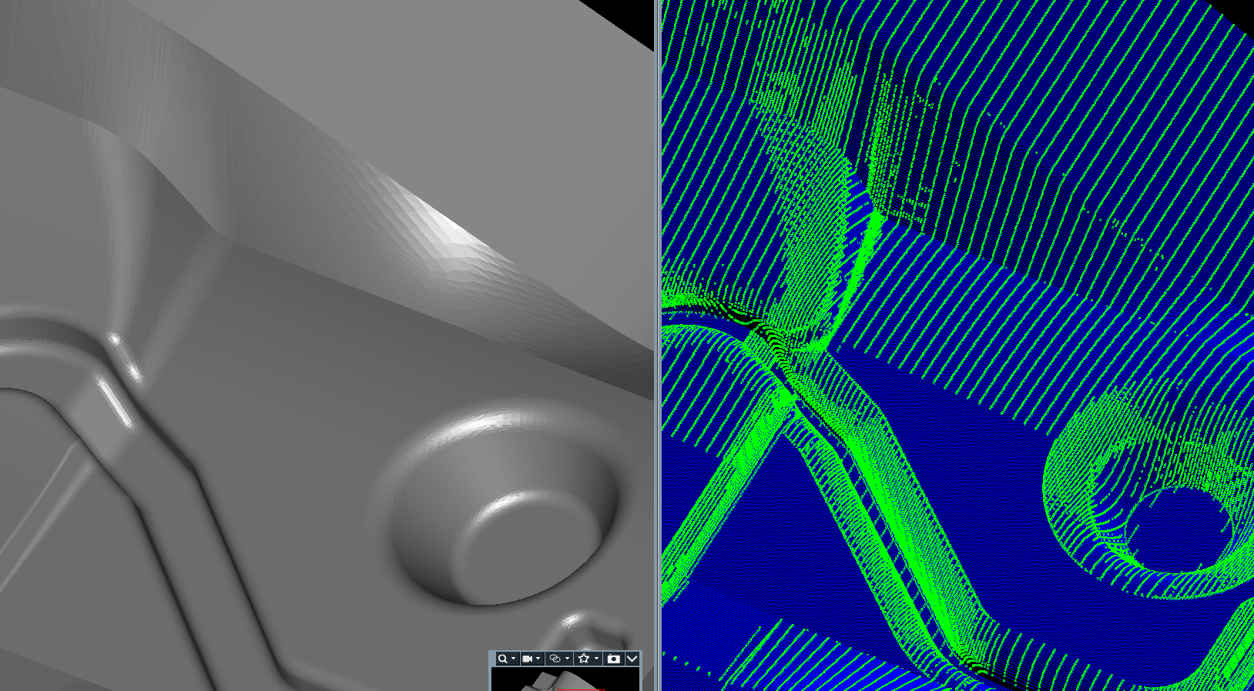
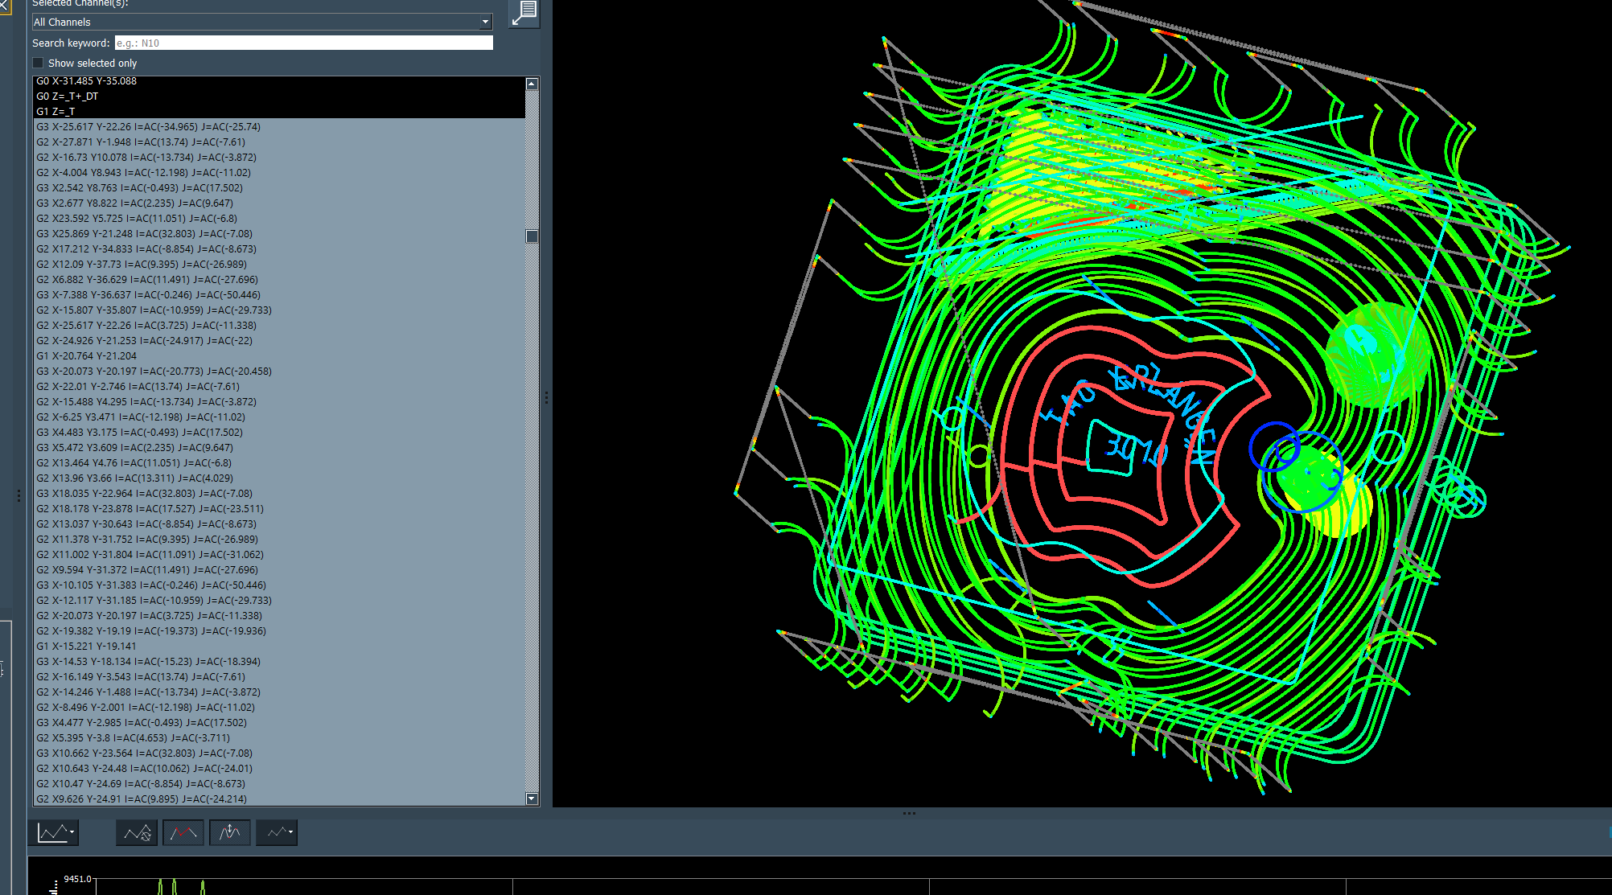
Analyze MyWorkpiece /Toolpath Data analysis reveals the root cause of quality and productivity problems
CAD-CAM environment
CNC system
CAD
CAM
POST
Digital twin
Real machine
G-Code
Simulated movement
Actual movement
Output of the CAD/CAM system
Draw conclusions regarding the final quality of the workpiece
Identify discontinuous tool paths
Output of CAD/CAM Environment
Identify characteristic patterns that could lead to issues in one of the later process stages.
Verify production-readiness of the data set.
Output from Run MyVirtual Machine
Visualize the dynamic behavior of the NC (e.g. compressor)
Identify problematic motion characteristics and poor contour accuracy
Data analysis with Industrial Edge or SINUMERIK Operate Trace
Analyze the behavior of the machine tool including drives and mechanical influences

Slide 7
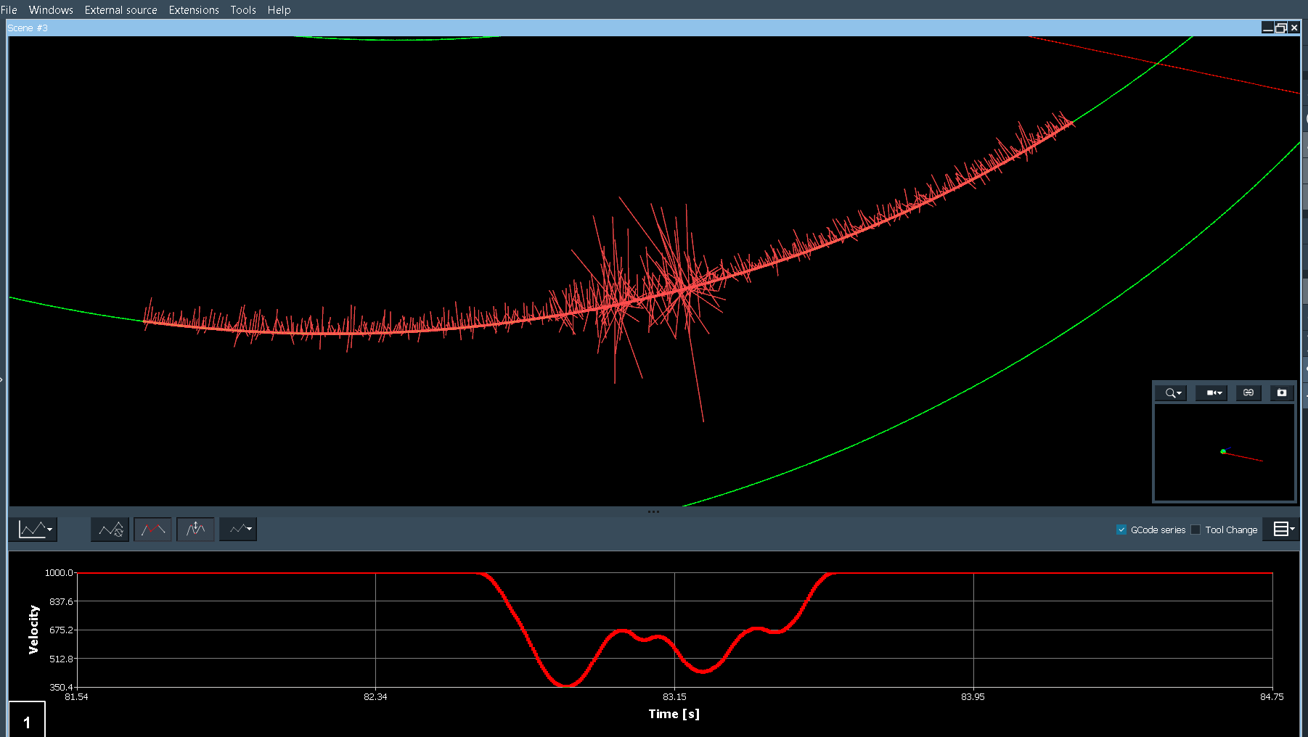
Analyze MyWorkpiece /Toolpath, Chiron Group SE - Basics of part program analysis
Siemens solution
Jumps of curvature on the tool trajectory directly lead to velocity drops, because of the resulting centripetal acceleration.
It can already be analyzed in the part programm, what effects may occure later. The reason for that is, if you look at it from the NC point of view, the curvatures of the points are affecting the polynomial formed by the compressor.

Slide 8
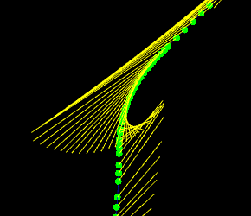
Analyze MyWorkpiece /Toolpath, Chiron Group SE - Improve process stability and reduce cycle times
Siemens solution
By using Analyze MyWorkpiece / Toolpath, the customer was able to detect errors on the workpiece from design and programming to processing on the machine, thus improving the productivity and thus the process reliability of its CNC robot. In addition, we were able to achieve:
Faster identification of problematic areas and part program features
Better quality control of the process
The ability to develop NX CAM Multi Axis Additive in a way to better interface with the RMR Controller
More robust CAD/CAM Setup in Siemens NX and NC parametrization.
In spite of using a compressor, curvature jumps usually lead
to vibrations / feed rate dips.
Faulty orientation programming (yellow)
leads to feed rate dips.

Slide 9
Analyze MyWorkpiece /Toolpath, Chiron Group SE - Improve process stability and reduce cycle times
The Siemens solution
Before manufacturing
After manufacturing
3D visualization of the NC part program and geometry files
Analysis of point distribution, curvatures and orientations of the TCP path in the part program.
Advanced checking of contour accuracies and feed rate
Analysis of potential causes of surface defects as well as derived NC optimizations
3D visualization of the NC trace after interpolator/compressors (SINUMERIK HMI Trace)
3D visualization of virtual NC output (SINUMERIK HMI + Run MyVirtual Machine)
Generated 3D visualization models allow the analysis and optimization of the actual machining process of the workpiece (position, velocity, acceleration, performance indicators) to eliminate problems with the workpiece quality.
Toolpath color coding, 3D measurement functions, surface rendering

Slide 10
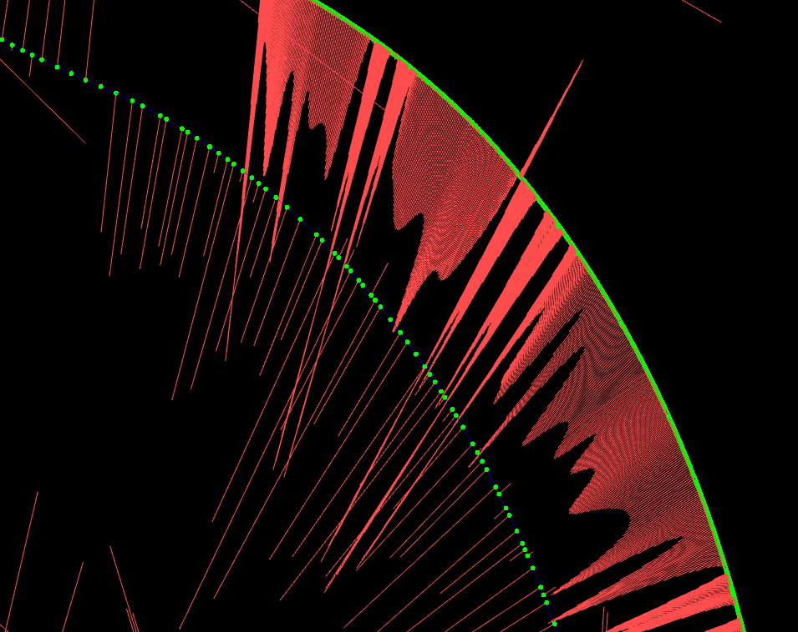
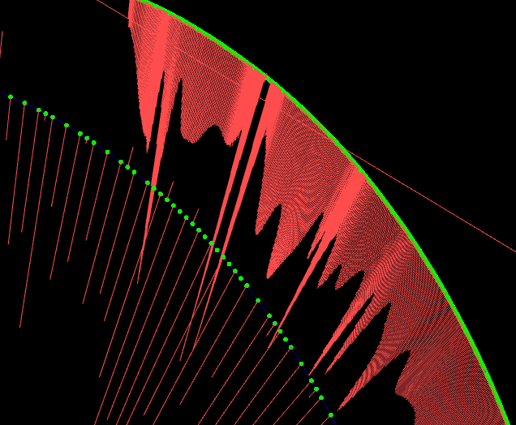
Analyze MyWorkpiece /Toolpath, Chiron Group SE - Improve process stability and reduce cycle times
Customer value:
G-code optimization after analysis via
AMW /Toolpath: Omission of intermediate points (NX)
Quickly locate the problem, significantly reducing the time needed for optimizations and producing test parts.
Advantages of Analyze MyWorkpiece /Toolpath:
Tooling preparation time was reduced by up to 50%
Error-parts on the actual machine were reduced by up to 99% when an analyzation of the part program was done digitally before.
GCode
NC Trace
TCP Speed
TCP Speed
Heavy vibration of the robot due to faulty points in the G-code program prevents processing.
Much more harmonious speed profile, approx. 10% faster
Notes:
Getting from A to B: NX: Omit option Set intermediate points automatically (by point distance).

Slide 11
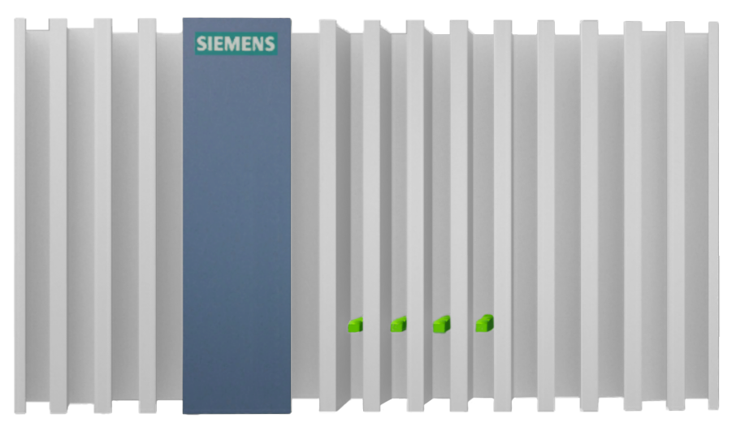
Analyze MyWorkpiece /Toolpath, Chiron Group SE - Improving surface quality and the productivity of machine tools
Why Siemens?
We have a Siemens product with Analyze MyWorkpiece / Toolpath, which is deeply integrated into the overall system and enables optimal SINUMERIK data access. In interaction with Create MyVirtual Machine, the digital twin of Sinumerik, optimization/diagnosis can be carried out at the office, almost completely eliminating error-parts and material waste.

Slide 12
Disclaimer
© Siemens 2023
Subject to changes and errors. The information given in this document only contains general descriptions and/or performance features which may not always specifically reflect those described, or which may undergo modification in the course of further development of the products. The requested performance features are binding only when they are expressly agreed upon in the concluded contract.
All product designations may be trademarks or other rights of Siemens AG, its affiliated companies or other companies whose use by third parties for their own purposes could violate the rights of the respective owner.

Slide 13
Security Information
Siemens provides products and solutions with industrial security functions that support the secure operation of plants, systems, machines and networks.
In order to protect plants, systems, machines and networks against cyber threats, it is necessary to implement – and continuously maintain – a holistic, state-of-the-art industrial security concept. Siemens’ products and solutions constitute one element of such a concept.
Customers are responsible for preventing unauthorized access to their plants, systems, machines and networks. Such systems, machines and components should only be connected to an enterprise network or the internet if and to the extent such a connection is necessary and only when appropriate security measures (e.g. firewalls and/or network segmentation) are in place.
For additional information on industrial security measures that may be implemented, please visit https://www.siemens.com/industrialsecurity.
Siemens’ products and solutions undergo continuous development to make them more secure. Siemens strongly recommends that product updates are applied as soon as they are available and that the latest product versions are used. Use of product versions that are no longer supported, and failure to apply the latest updates may increase customer’s exposure to cyber threats.
To stay informed about product updates, subscribe to the Siemens Industrial Security RSS Feed under https://www.siemens.com/industrialsecurity.

